Slide 1
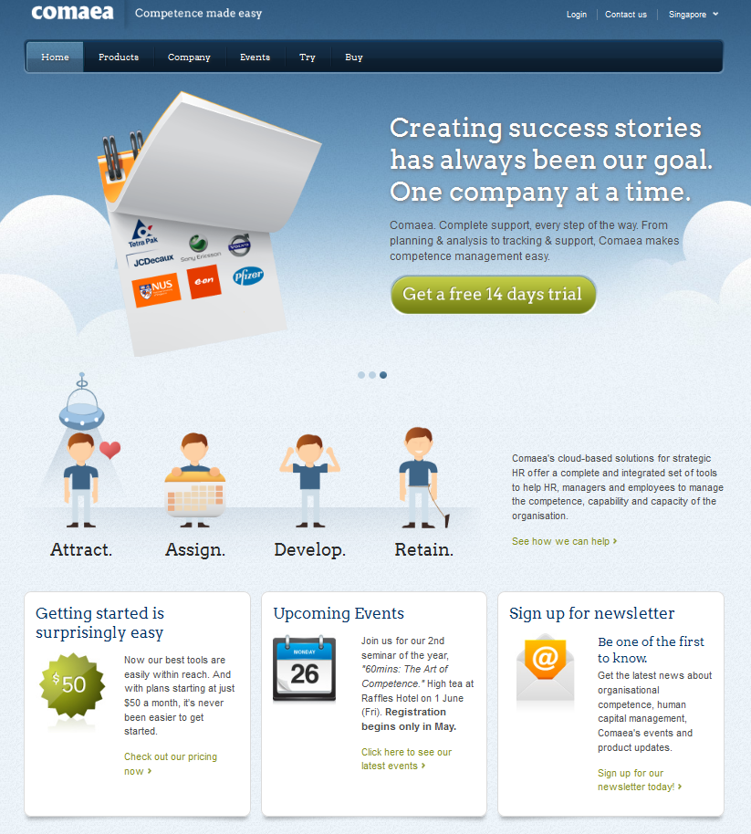
Comaea HCM
Example Screens Indicator Assessment
Conference EQUATE, 31 March 2014
VERSION A

Slide 2
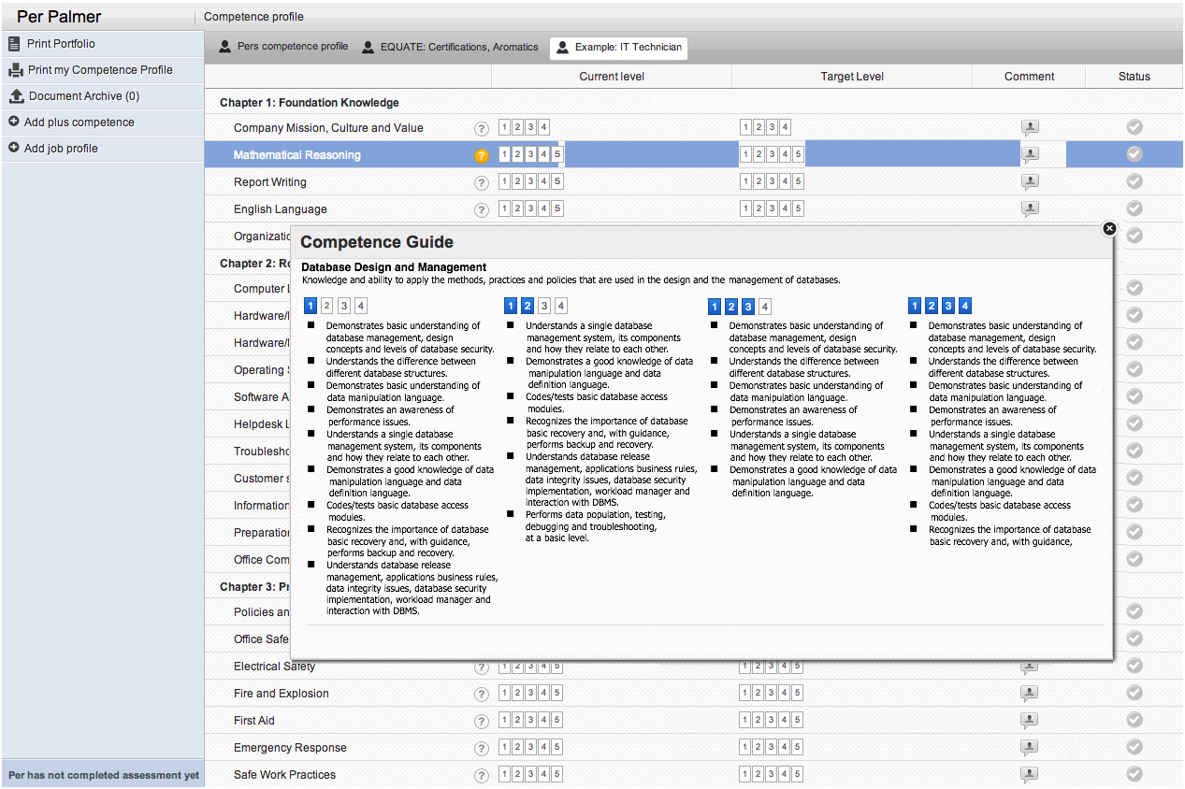
Indicators / Not selectable

Slide 3
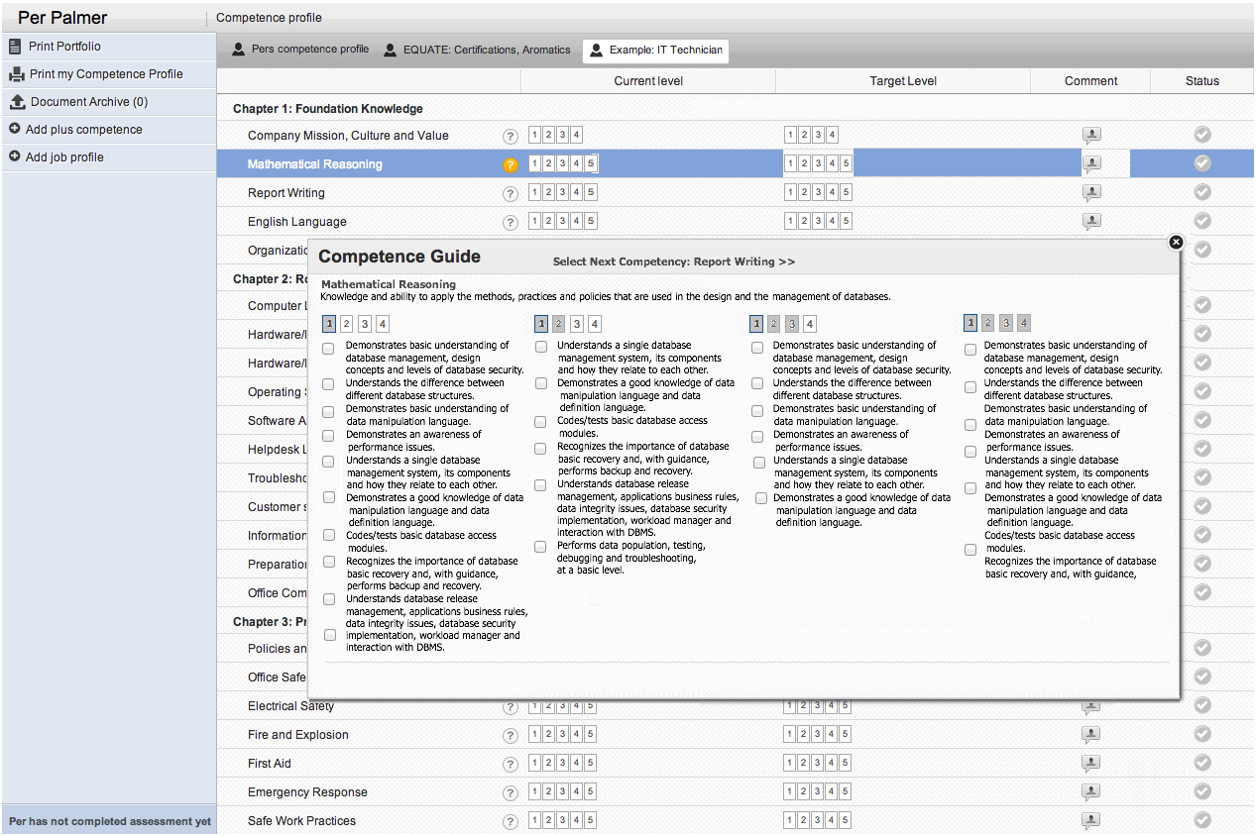
Indicators / Selectable (step 1)

Slide 4
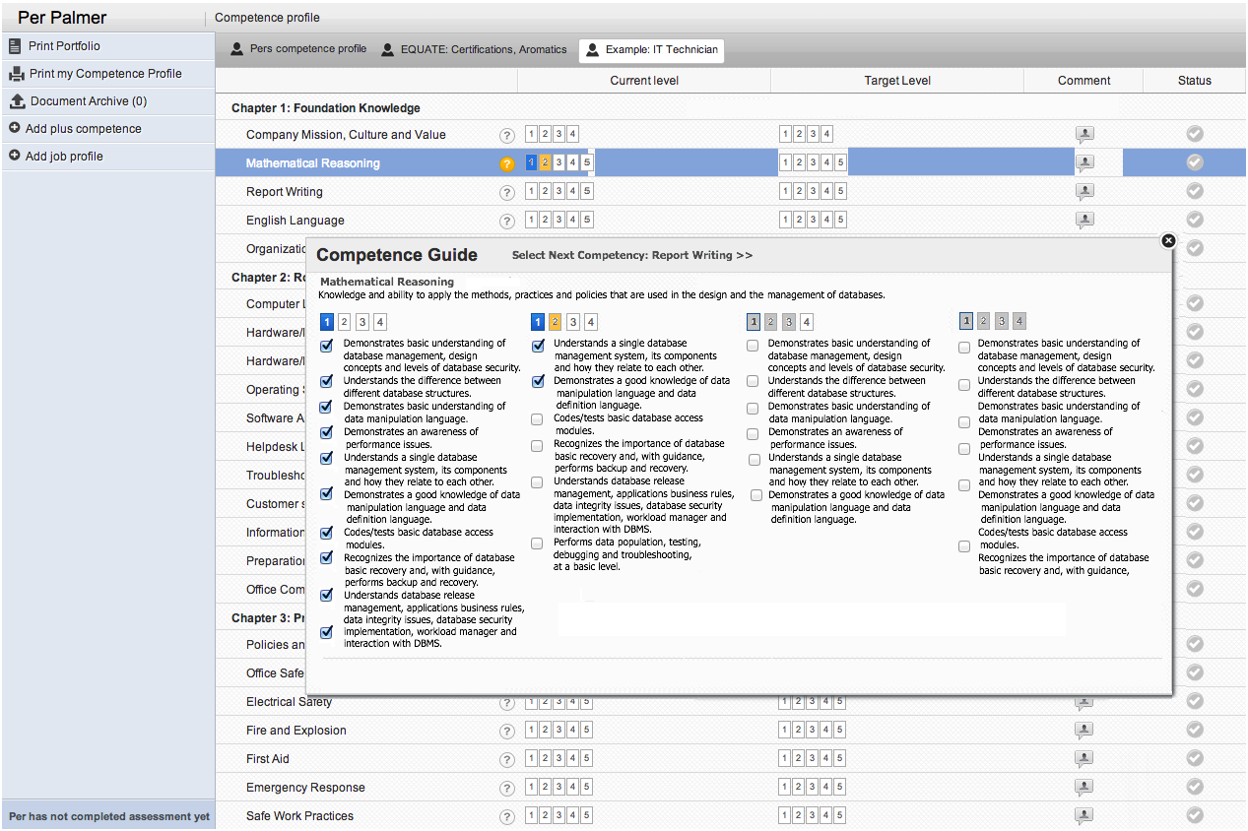
Indicators / Selectable (step 2)
If the user uncheck any indicator for a proficiency, level turn Orange, to indicate that the user is not fully complying to all Indicators for that Level. Correspondingly, this shall be refleted in the main page.

